Slide 1
PRAGMA³¹ Student Hackathon
Lightning Green
High Performance Computing and Networking Center
Department of Computer Engineering
Kasetsart University

Slide 2
motivation / inspiration
Why you want to do this work?
Interested in network technology
What is going to be better with your work done?
Add new switch to network
Get to learn and try PRAGMA, SDN, Open vSwitch, etc.

Slide 3
step of the assigned task
Install Rocks cluster frontend
Register host with PRAGMA Cloud Scheduler
Install pragma_boot
Install and configure Open vSwitch and GRE Link

Slide 4
Architecture
Configure Open vSwitch and Enable ENT
Connect to GRE
PRAGMA05
Setup PRAGMA Boot VM
Connect with OpenFlow Controller
Configure Rocks and Register with Cloud Scheduler
Setup Open vSwitch
Setup Rocks
Configure VM
VM
eth0
eth1
OVS (ens5)
112.121.136.25
10.110.0.7
SD_LEMON
eth0
eth1
112.121.136.24
tap
br0 (ovs)
OF Controller
peth0
peth1
10.110.0.5
163.221.11.93:6653
Internet
TU GRE
203.131.208.4

Slide 5
Install Rocks cluster frontend

Slide 6
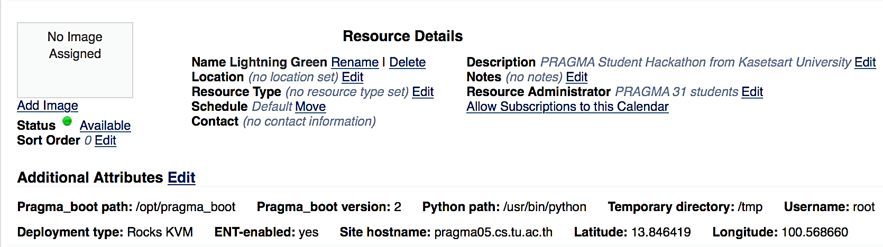
Register host with PRAGMA Cloud Scheduler

Slide 7
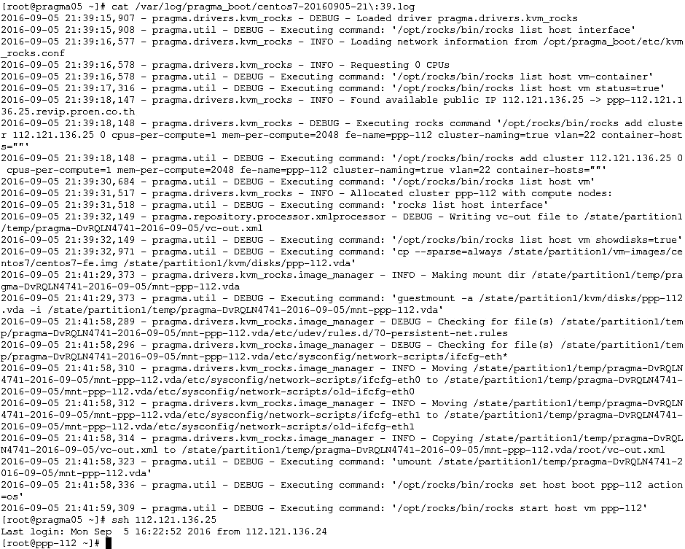
Install pragma boot

Slide 8
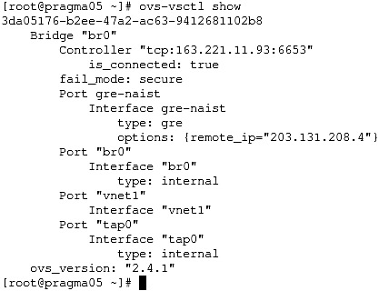
configure Open vSwitch and GRE link

Slide 9
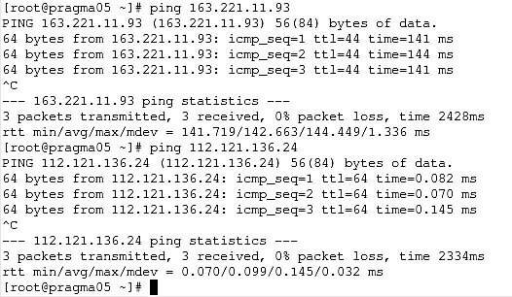
Test pinging to the controller

Slide 10
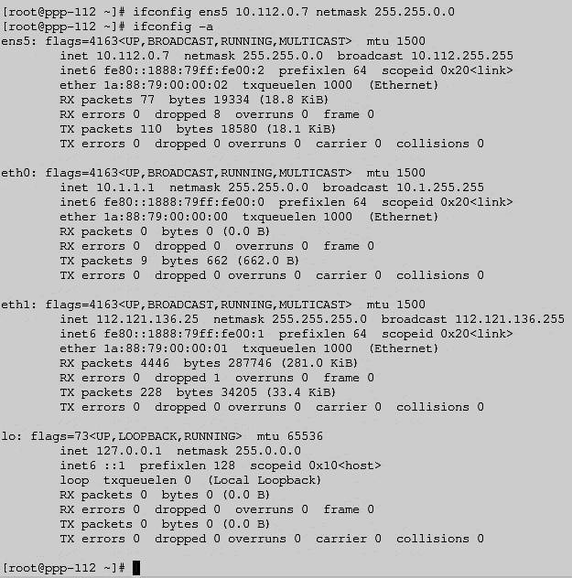
Setting up interfaces on Virtual cluster

Slide 11
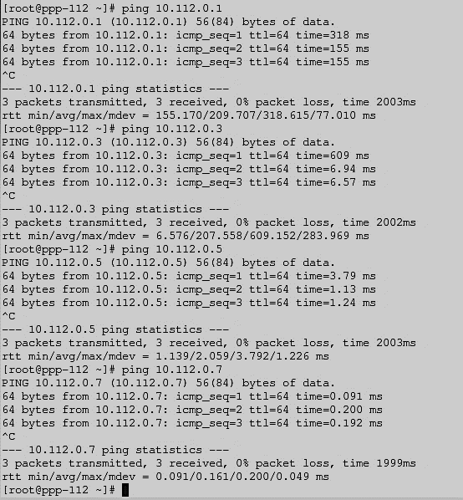
Test ping To GRE Links

Slide 12
Architecture
PRAGMA05
VM
eth0
eth1
OVS (ens5)
112.121.136.25
10.110.0.7
SD_LEMON
eth0
eth1
112.121.136.24
tap
br0 (ovs)
OF Controller
peth0
peth1
10.110.0.5
163.221.11.93:6653
Internet
TU GRE
203.131.208.4

Slide 13
What we have learnt
Open vSwitch
GRE Link
The PRAGMA Architecture
In-depth computer networking

Slide 14
What We have learnt
The most challenging part
Connect the front-end to Controller (SD-LEMON)
Configuring GRE Link
The easiest part
Install Rocks cluster in front-end

Slide 15
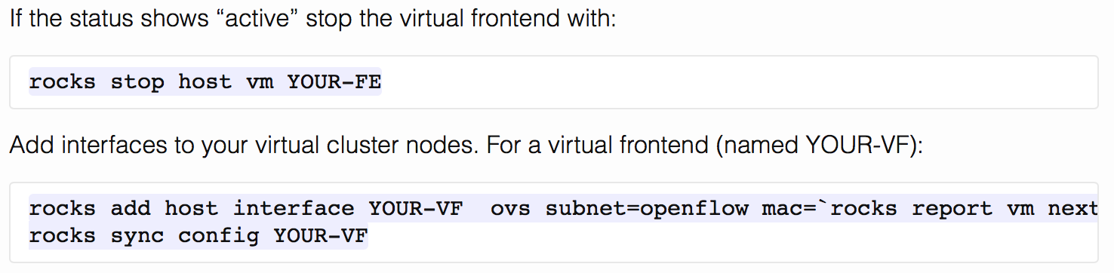
Impressions
What we have done well?
Foods and Venue
Comprehensive documentation
What we need to improve?
Certain parts of the document are not clear or misleading

Slide 16
Q&A
Time for questions

